Slide 1
Grocery Shopping Habits
Machine Learning Applications
Lucas Jennings
Github.com/lbjennings/Springboard
LinkedIn.com/lbjennings
Springboard Course Work
2018

Slide 2
Buried Under Data
3.4 Million Orders
206 K Customers
50 K Products
134 Aisles
21 Departments
“The Instacart Online Grocery Shopping Dataset 2017”, Accessed from https://www.instacart.com/datasets/grocery-shopping-2017 on 17 Jan 2018"

Slide 3
Data Science Helps
Uncovers the story
Provides a sense of direction
Tools to handle seize opportunities
An asset to both customers and company

Slide 4
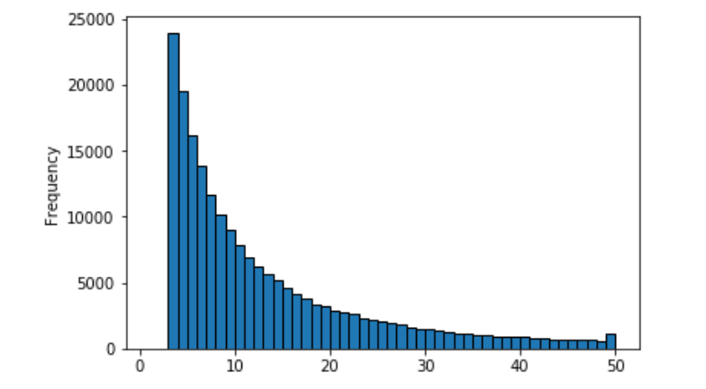
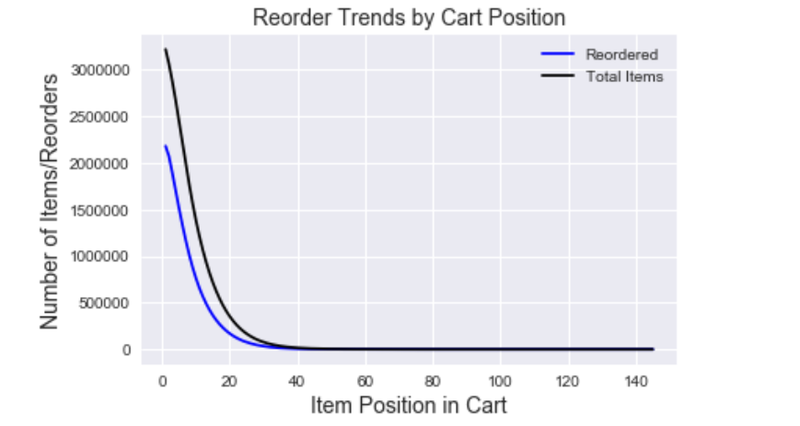
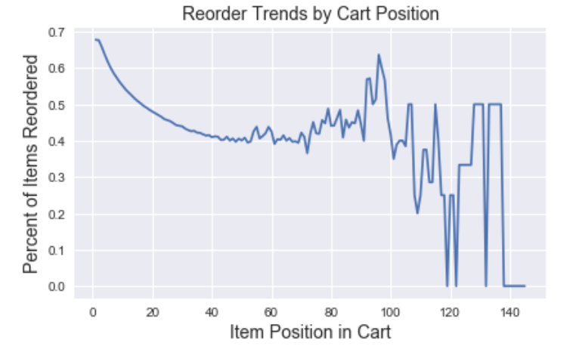
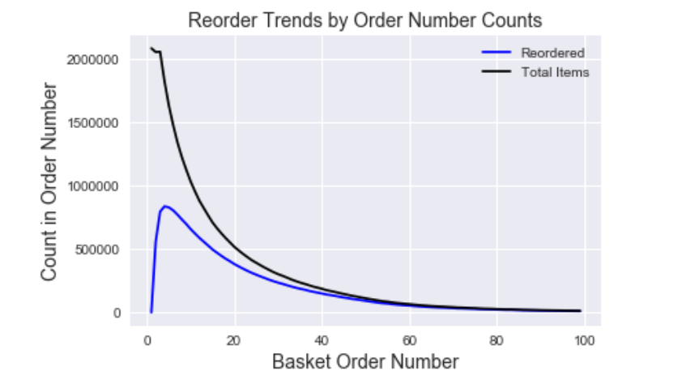
The Data Story
The typical customer purchases 17 Items
The typical basket has 6 Reorders
First item is a reorder 70% of the time
Reorders drive sells

Slide 5
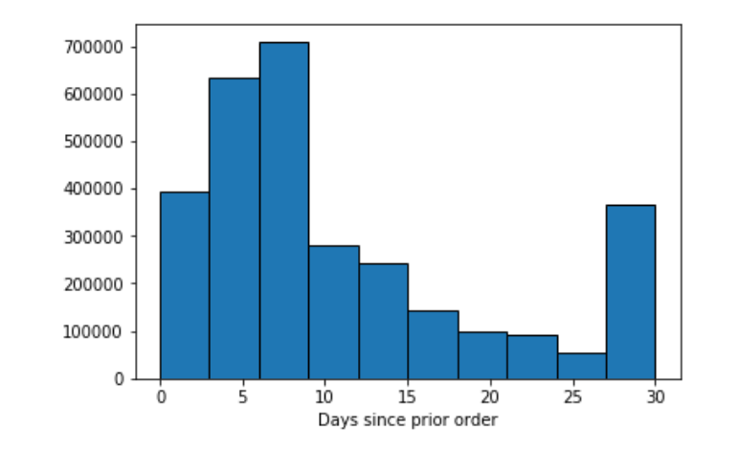
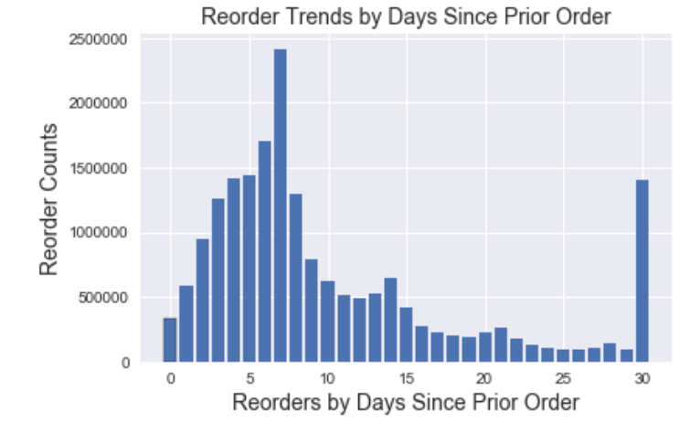
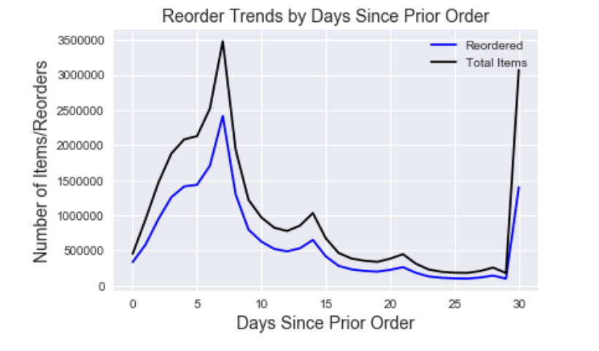
How can we help the customer?
Reorders drop after 7 days
Lets help the customer remember products.
Lets recommend items on their next visit.

Slide 6
Machine Learning Models provide the tools.
The Single Vector Machine
A technique that uses
Random Forest Classifier:
Single Vector Decomposition: A method that uses collaborative filtering to recommend product that users liked previously as well similar customers preferences.

Slide 7
SVM
Pros
A technique that is nice with data with lots of features.
\
Cons
Does not scale well. Usually will have to readjust the tuning parameters as data size grows.
Computationally expensive to tune as data grows.

Slide 8
Random Forest Classifier
Pros
Easy to understand how the decision process
\
Cons
Tends to overfit on training data.

Slide 9
Single Vector Decomposition
Pros
A technique that is nice with data with lots of features.
\
Cons
Does not scale well. Usually will have to readjust the tuning parameters as data size grows.
Computationally expensive to tune as data grows.

Slide 10
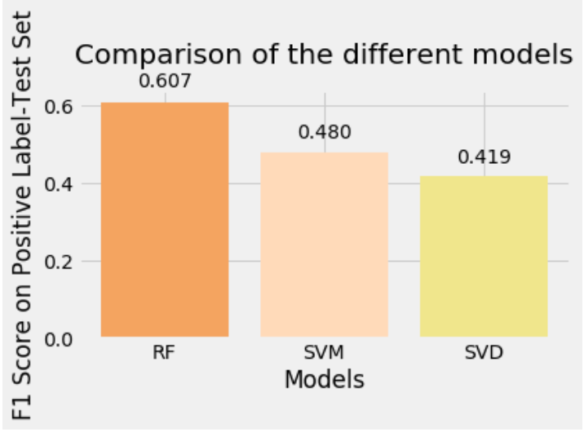
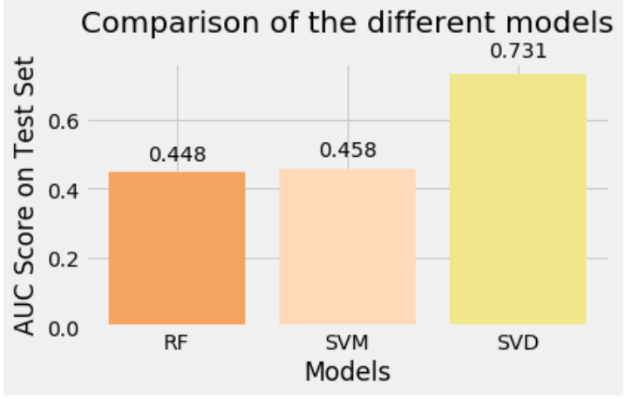
Results
Random Forest best at predicting reorders
Single Vector Machine best at predicting reorders overall

Slide 11

Lets Change This!
Opportunity to drive sells by driving reorders
Helping Customers get more of the things they like and want.

Slide 12
Build A Recommender
Safe to move forward. A way to measure success.
Improvement in Reorders after 7 days.
We Get Happier Customers.
No Reason not to Act

